Slide 1

COVID-19 TRACKING
BY:GROUP 1 An Nguyen, Nathan Kwok, Tyler Trinh, Hans Valderama

Slide 2
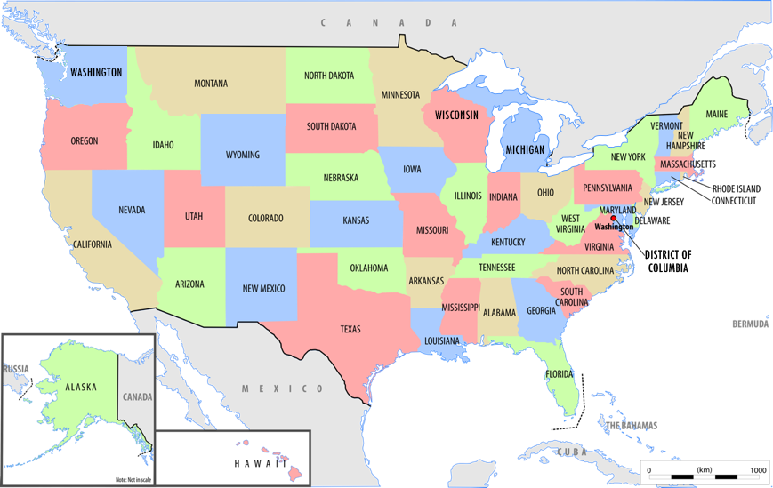

Introduction
The COVID-19-Associated Hospitalization Surveillance Network (COVID-NET) tracks weekly rates of confirmed COVID-19 hospitalizations in the U.S. This system provides data on hospital admissions across different age groups, races, and health conditions. It helps identify trends in severe cases, supporting public health efforts. COVID-NET data are used by policymakers to manage healthcare resources and guide response measures. This information is vital for understanding the pandemic’s impact on hospitals and communities.

Slide 3
Why Our Project Is Unique
As part of our project, we will analyze the number of hospitalizations caused by COVID-19. In other datasets we have found that they mainly focused on the mortality rates that COVID-19 had impacted; however, we will focus more on tracking where hospitalizations happened in the United States. We would make assumptions based on the given dataset and draw conclusions based on what we find. We ask questions such as “Why were more people affected in this state?” or “Why was this age group less susceptible compared to the others?”

Slide 4
How Our Project Relevance To The Class
In our project we use Gitbash to download our dataset and import it into Elasticsearch from the csv file and use that for specific data analyzation just like in our weekly lab assignments. We are then able to filter our data, create visualizations such as the bar graph or pie chart, select specific time frames and create a regression model. By learning how to use Elasticsearch throughout the course and completing lab assignments that go over the many different features, we gain the skills to analyze the COVID-19 hospitalization data. This allows us to provide insights, and use data analytics to find trends or patterns in our data.

Slide 5
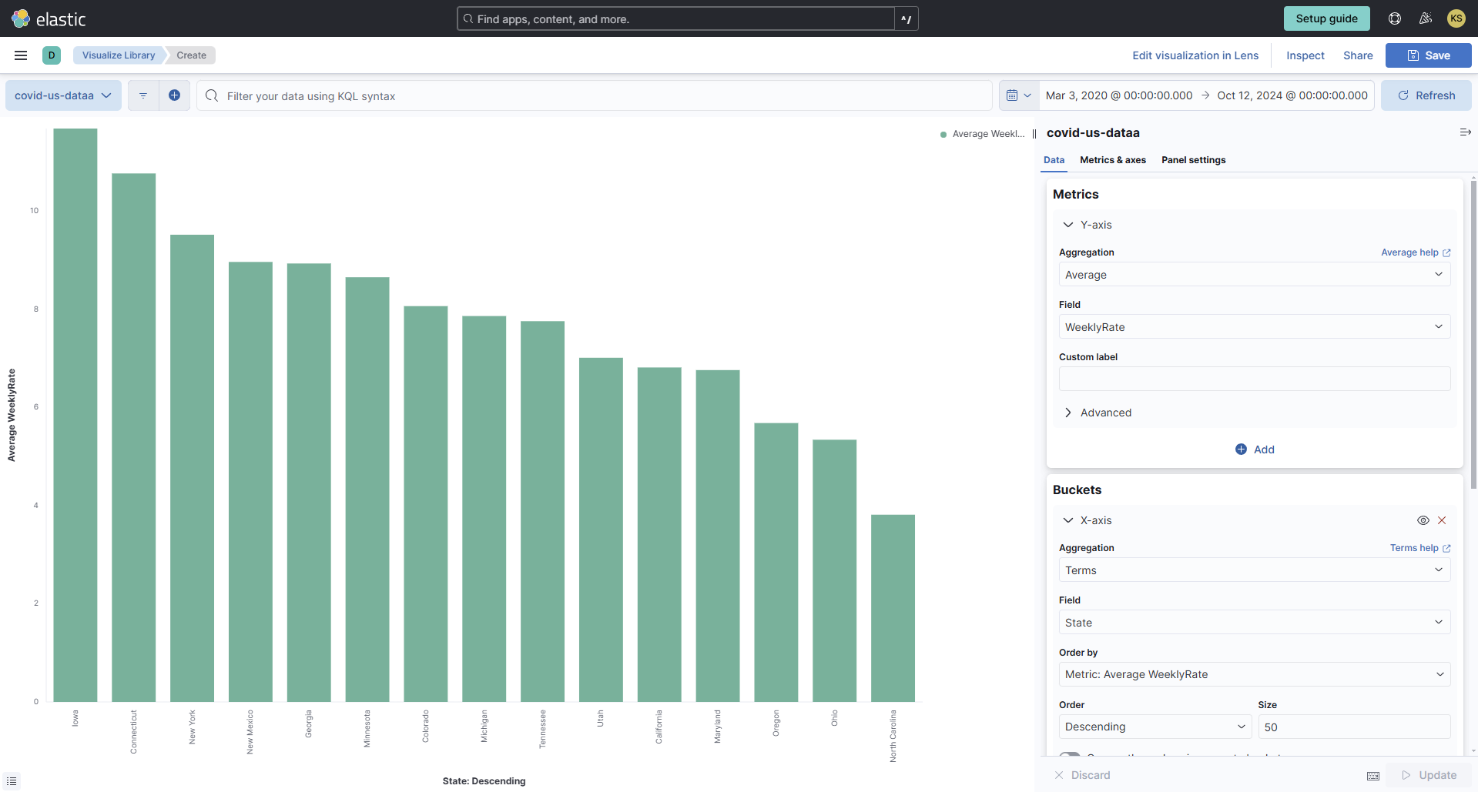
Bar Chart: States With Highest Average Weekly cases

Slide 6
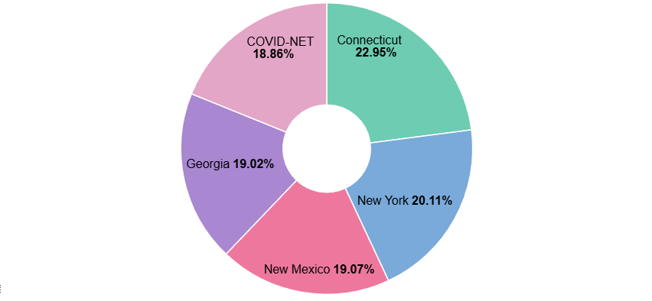
Visual Chart: Top 5 States
Crowded population
Slow to react
Figure 1: Covid case pie chart

Slide 7
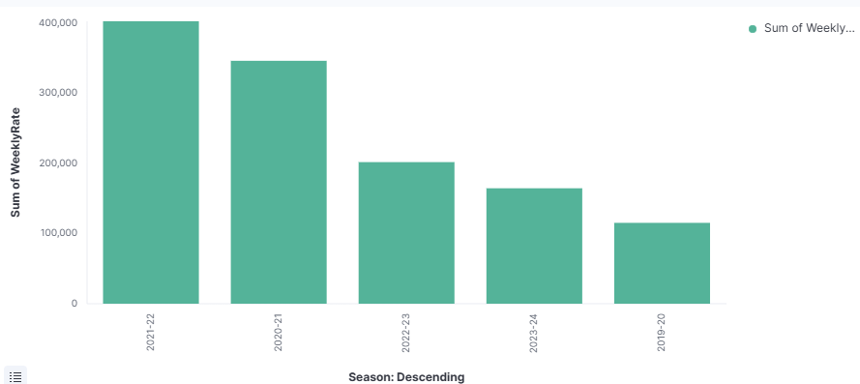
Visual Chart: Top 5 Covid Time
Happen in Summer
People go on vacation
Others travel
Figure 2: Covid case by timeline bar chart

Slide 8
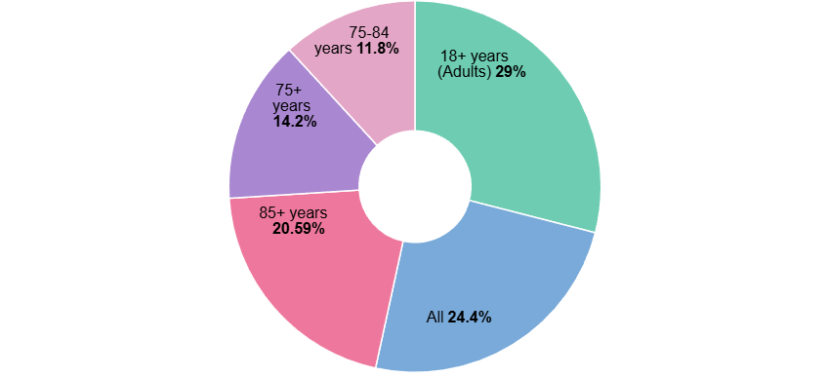
Visual Chart: Age Range
In a gender survey, "all genders" is a term that refers to someone who identifies as every possible gender option. "Others" is a text field that allows respondents to define their gender in their own words.
Figure 3: Covid case by ages pie chart

Slide 9
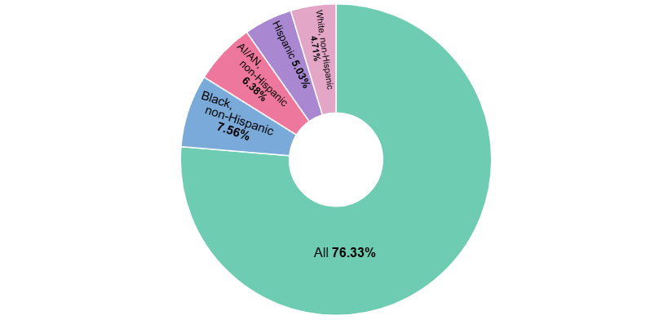
Visual Chart: Race
High property rate
Lack of medical essentials
Crowded area
Lack of vaccines
Figure 4: Covid case by races bar chart

Slide 10
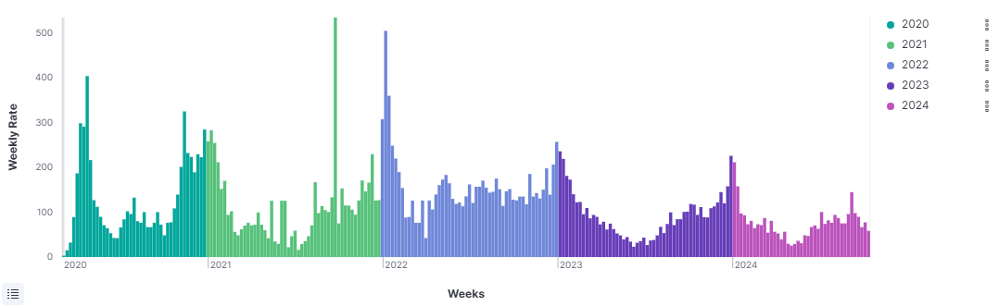
Visual Chart: Weekly Hospitalization
Figure 5: Covid case weekly (machine learning)
Max: 534 Cases on 2021-09-20
Min: 15 Cases on 2021-07-05

Slide 11
Conclusion
Key Findings:
COVID-19 hospitalizations varied significantly by state, with the highest weekly cases occurring in densely populated areas with limited healthcare resources.
Age and racial demographics revealed distinct trends, such as younger age groups being less affected and disparities among races due to socioeconomic factors.
Peak hospitalization occurred in September 2021, with minimal cases in July 2021, reflecting seasonal trends and travel behaviors.
Utilized Elasticsearch/Kibana to analyze and visualize data, created a lab tutorial and enhancing practical data analytics skills.

Slide 12
...and our sets of editable icons
You can resize these icons without losing quality.
You can change the stroke and fill color; just select the icon and click on the paint bucket/pen.
In Google Slides, you can also use Flaticon’s extension, allowing you to customize and add even more icons.

Slide 13
Educational Icons
Medical Icons

Slide 14
Business Icons
Teamwork Icons

Slide 15
Help & Support Icons
Avatar Icons

Slide 16
Creative Process Icons
Performing Arts Icons

Slide 17
Nature Icons

Slide 18
SEO & Marketing Icons

